Slide 1
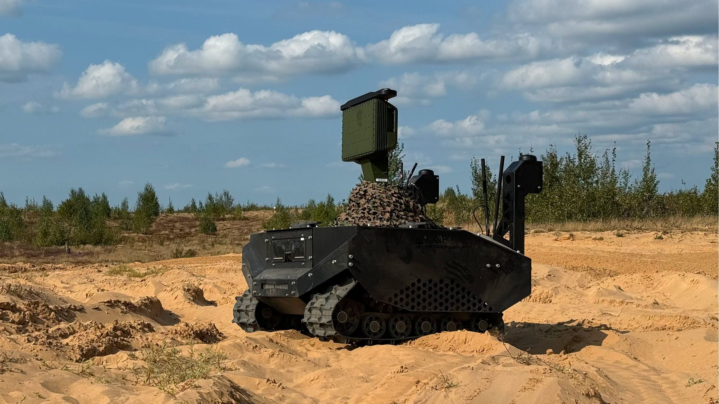


Unmanned Ground Vehicle
Redefining Human Detection with Radar-Assisted AI Technology
Harsh Patel
• Real-time human detection • Operation in low-light/night conditions • Sensor fusion (Camera + Radar) • Autonomous UGV mobility • High detection accuracy & low false alarms • Deployable for security and rescue applications
Autonomous vision-radar fusion system for reliable night-time human detection.
PROTOTYPE 1 – Radar-Based Detection System
Human detection in low-light conditions presents significant challenges for conventional camera-based systems due to poor illumination and high computational demand. This project proposes a two-prototype Unmanned Ground Vehicle (UGV) architecture focused on energy efficiency and detection reliability.
Prototype 1 utilizes a DreamHat radar sensor for initial human presence detection based on motion and distance measurements. This approach reduces computational load and conserves battery power, enabling efficient continuous patrol.
Prototype 2 enhances the system by integrating a camera and YOLOv8 deep learning model. The radar acts as a trigger mechanism to activate vision-based detection only when necessary. This hybrid sensor-fusion strategy improves detection accuracy while optimizing power consumption.
The proposed system demonstrates an intelligent balance between performance and energy efficiency, making it suitable for surveillance, defense, and search-and-rescue applications in low-visibility environments.
Objective:
Develop a lightweight, energy-efficient system using radar-only sensing.
Working Principle:
UGV patrols continuously
Radar detects motion and distance
Human presence estimated from radar reflection patterns
Alert triggered without camera processing
Advantages:
Low power consumption Fast response time Suitable for continuous monitoring Minimal processing requirement
PROTOTYPE 2 – Radar + YOLOv8 Vision Fusion System
Objective:
Improve detection accuracy using sensor fusion.
Working Principle:
Radar detects motion
Camera activates only when radar confirms presence
YOLOv8 performs human classification
Sensor fusion algorithm increases confidence
Reduced false positives
Advantages:
Higher detection accuracy Reduced unnecessary camera usage Balanced power consumption Intelligent target verification
References
Harsh Patel BE Electronic Engineering
Roboflow (Dataset Preparation & Export)
https://app.roboflow.com/room-qsnrv/kitti-low-light-tvbas/1/export
Survey on UGV Navigation & Detection
https://www.mdpi.com/1424-8220/20/8/2286
[hp520@live.mdx.ac.uk]
[Insert twitter username]

